Slide 1
Incident Business
Center Manager Meeting
November 2019

Slide 2
Personnel Update
Real ID/Enhanced Driver’s License
AD Payment Status Report
AD Injuries – eSafety Contacts
Service & Supply Plan
Guide to Service Animals on Incidents
Upcoming Training

Slide 3
Personnel Update
Randee Olson
Processing state reimbursements
David Laboy
Incident Business Specialist (Vice Sandra Williams)
David.Laboy@usda.gov
414-297-1273

Slide 4
Real ID/Enhanced Driver’s License
Passed by Congress in 2005; managed by DHS
https://www.dhs.gov/real-id-public-faqs
Effective date: Oct 1, 2020
Required to board federally regulated commercial aircraft
Enhanced Driver’s Licenses (EDL) issued by Washington, Michigan, Minnesota, New York, and Vermont are considered acceptable alternatives to REAL ID-compliant cards and will also be accepted for official REAL ID purposes.
Start educating resources

Slide 5
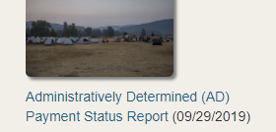
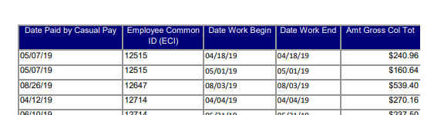
AD Payment Status Report
Available on the Incident Business Practices (IBP) webpage which is forward facing to the public
https://www.fs.fed.us/managing-land/fire/ibp
Select link from icon located in middle of lower row
Search by ECI Number

Slide 6
AD Injuries – eSafety Contacts
AD injuries are entered into eSafety
The Sponsoring Unit needs to identify a “supervisor” for purposes of eSafety – usually hiring official
Provide eSafety “supervisor contact information” to David Laboy

Slide 7
Service & Supply Plan
It is the incident agency responsibility to establish and annually update a Service & Supply Plan (SIIBM p. 20-1)
Land Use and Facility Rental Agreements
BPAs & IBPAs
Available local open-market sources
List sources for heavy-demand items, such as bottled water, food items and food service (including menus), hand tools, fuel, and vehicle and equipment rentals and repairs.
Local interagency agreements and operating plans.
Contact information for incident agency acquisition staff
Templates for Delegation of Authority letters

Slide 8
Service & Supply Plan
Have available hard copy or electronically (thumb drive, etc.)
Templates and samples are available
Modify to fit unit

Slide 9
Guide to Service Animals on Incidents
NWCG issued guidance in April, 2019
Refer to SIIBM p.10-24
Posted to IBC webpage and EACC IB page.
IBC page: https://www.nwcg.gov/committees/incident-business-committee
The use of a service animal is a reasonable accommodation (RA) an employer provides to an employee with a disability.

Slide 10
Guide to Service Animals on Incidents
Anyone who requires a RA to perform duties in an incident environment must have written approval for that RA from their home-unit
Prior to accepting an assignment, individuals should alert the incident of the RA needs
If the RA cannot be satisfied, the individual should refuse the assignment

Slide 11
Upcoming Training
Incident Procurement Training
March 9-13, 2020
USFS Regional Office, Milwaukee
Advanced COST
May 11-15
Location TBD; most likely in Southern Area
L-975 Unit Leader
May 11-15
Location TBD; most likely in Southern Area

